Slide 1


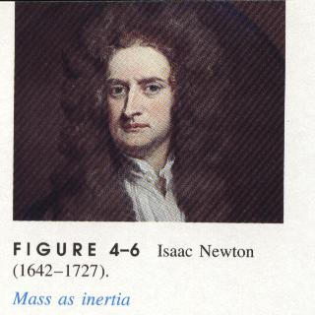

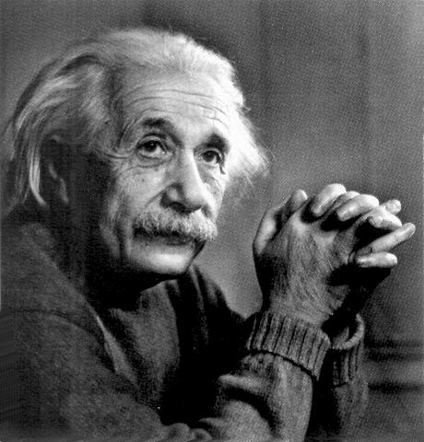
UNIVERSITY PHYSICS

Slide 2
1. Motion of a Rigid body
刚体的平动、转动和定轴转动
2. Torque The Law of Rotation rotational Inertia 力矩 刚体定轴转动定律 转动惯量
3. Applying the Law of rotation 转动定律的应用
4. Kinetic Energy and Work in Rotational Motion 定轴转动的动能定理
5. Angular Momentum of a rigid Body Conservation of Angular Momentum
定轴转动的刚体的角动量定理
和角动量守恒定律

Slide 3

教学基本要求
1. 理解描述刚体定轴转动的基本物理量的定义和性质；
2. 理解力矩、转动动能和转动惯量的物理意义；
3. 掌握定轴转动的转动定律和角动量定理；
4. 掌握定轴转动的角动量守恒定律和机械能守恒定律。

Slide 4
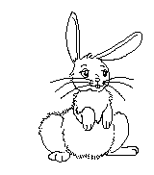
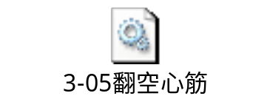
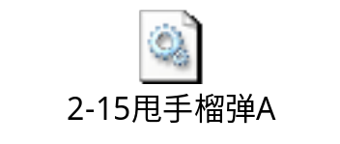
Now, we consider the motion of a body with a certain size and shape:
大小和形状！

Slide 5

The body without deformation is called a rigid body.
铁石心肠
不可塑造

Slide 6
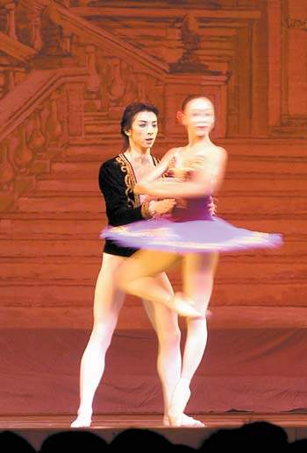

Its motion includes usually two types:
(1) translation（平动）;
(2) rotation（转动）。
Examples: dancing, skating, motion of Earth, motion of electron in the atom world,…….

Slide 7
1 Motion of a Rigid Body
刚体的平动、转动和定轴转动
1. The model of a rigid body 刚体模型
Rigid body（刚体） : an ideal model
The distance between two points in a rigid body maintains constant forever. Thus the body has a perfectly definite, unchanged shape and size .
刚体是一种理想模型：刚体是在任何外力作用下任意两点间
均不发生位移，形状大小均不发生改变的物体。

Slide 8
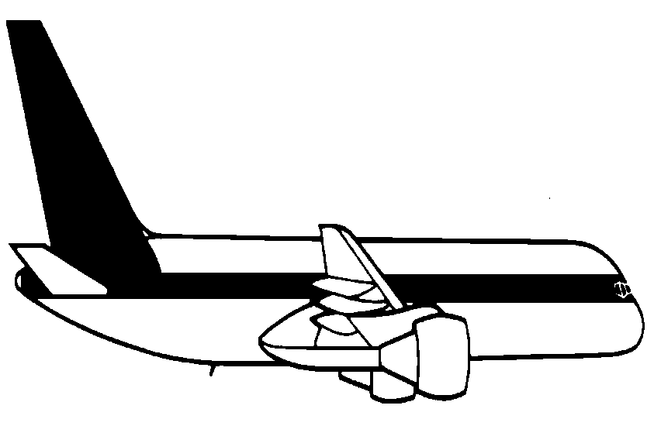
2. Translation & Rotation of a rigid body 刚体的平动和转动
(1) Translation（平动） :
看成质点
All particles describe parallel（平行） paths, and have the same velocity & acceleration. Therefore,the motion of any point of the body can represent the translational motion of entire（整个） rigid body.
(平动：刚体上所有点的运动轨迹都相同，可当作质点来处理。)
水平飞行

Slide 9
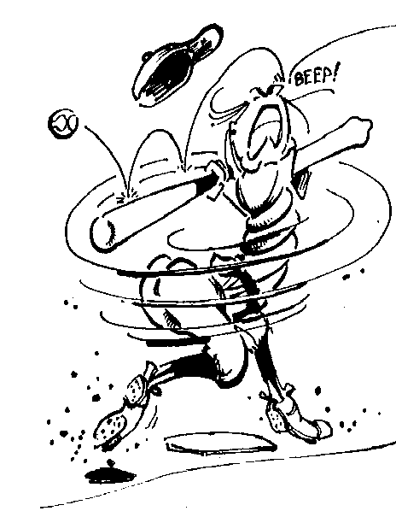
(2) Rotation:
圆周运动
All particles describe circular paths around a line called the axis（轴） which may fixed or may changing its position during the motion.
(转动：刚体上各点都绕某一轴作圆周运动，转轴可能是固定的也可能在运动中改变位置。)

Slide 10


(3) Translation and Rotation at same time
Often a rigid body can simultaneously(同时） have two kinds of motions.
平动和转动

Slide 11
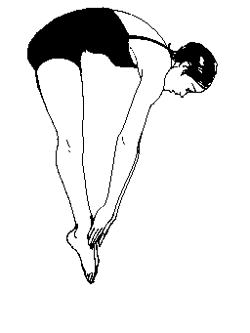

平动和转动（转轴位置变）
定轴转动

Slide 12


3. Rotation of a rigid body around a fixed axis
刚体的定轴转动
Example: A rotation around a fixed axis
Every point of the rigid body moves in a circle(刚体上各点都作圆周运 动).
轴

Slide 13
All the points in the rigid body:
To rotate around an axis.
P
Circular motion with different radii.
Q
（ 刚体上各点都绕同一转轴作不同半径的圆周运 动)
轴

Slide 14
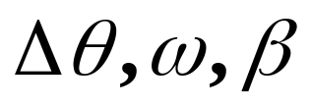
（1）Characteristic: all points have the same angular displacement, angular speed & angular acceleration.
特点：
各质点均在垂直转轴的平面内作圆周运动且角位移，角速度和角加速度均相同。
P
Q
轴

Slide 15



We select（选择） one arbitrary(任意） point P in the body whose circular motion can represents the motion of the entire body and use its circular plane as a reference to analyze（分析） the rotation of the rigid body around the fixed axis.
y
P
0
x
P
Q
轴

Slide 16
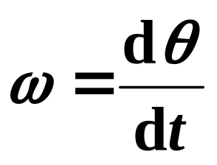
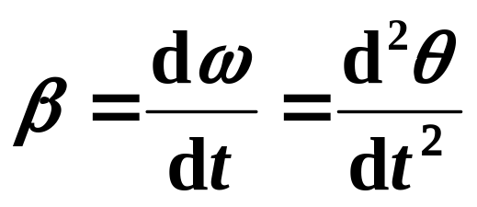
（2）Kinematics of rotation of a rigid body around a fixed axis is the same as the circular motion of a particle that we discussed in chapter 1.
P
Q
Representative(代表） P :
轴
θ
Δθ

Slide 17
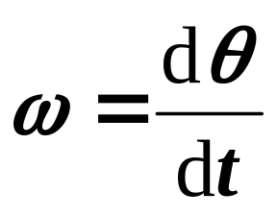
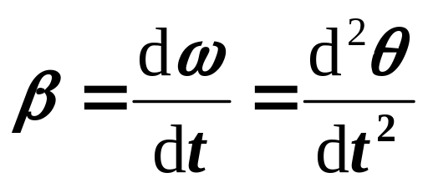
描述刚体定轴转动的物理量
✶ Angular displacement dθ
Angular speed
P
Q
Angular acceleration
轴

Slide 18
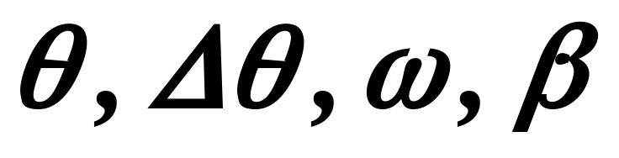
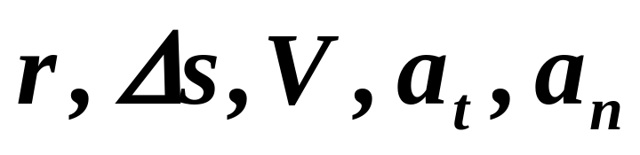
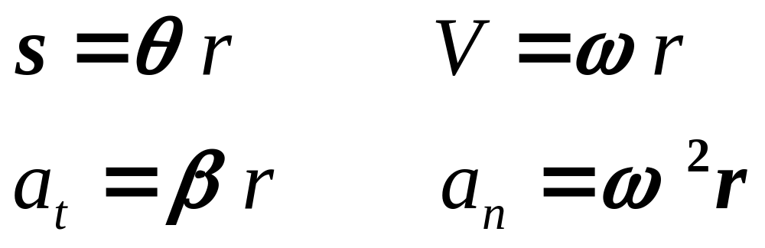
（4）Relation between two kinds of quantity
y
P
0
x

Slide 19
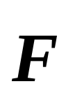
2. Torque The Law of Rotation Rotational Inertia
力矩 转动定理 转动惯量
1. Torque
Does a force make a rigid body rotate?
depending on its magnitude and acting position. Torque（力矩）!
Based on(根据) the concept of torque of a force acting on a particle with respect to a fixed point we can define the torque of a force acting on a rigid body.

Slide 20
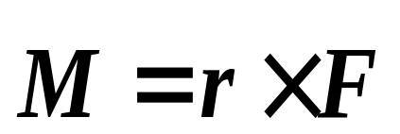

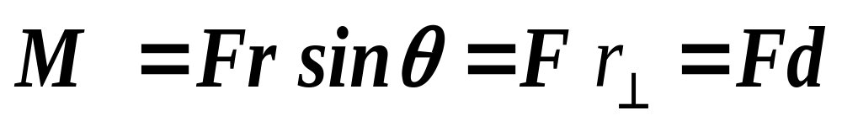



⑴ If the force acting on a rigid body is located in the plane perpendicular to the axis, the torque with respect to point o is defined as
P
The torque with respect to z axis is the Z-component of , Mz , briefly labeled as M
轴
z

Slide 21


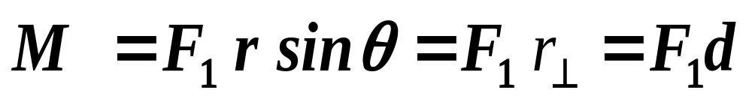
⑵ If the force is not placed in the plane perpendicular to the axis, we can resolve into ( in the plane)and ( at right angle to the plane). Obviously（显然）, only contributes to (有贡献）the torque :

Slide 22
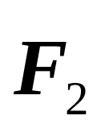
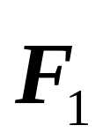
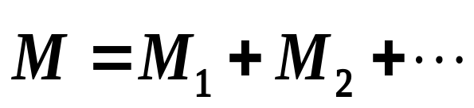
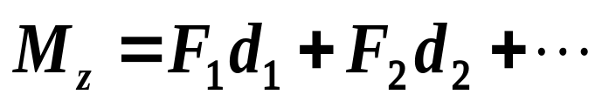
⑶ The resultant Torque 合力矩
P
轴
The torque have only two possible directions :
Counterclockwise（反时针）： positive
Clockwise(顺时针）： negative

Slide 23
说明：
与转轴垂直但通过转轴的力对转动不产生力矩；(Why?)
与转轴平行的力对转轴不产生力矩；(Why?)
刚体内各质点间内力对转轴不产生力矩。(why?)

Slide 24
2. The Law of rotation 转动定理(very important)
Our method is to treat（处理） the rigid body as a collection（集体） of particles with same angular acceleration and to apply（应用） Newton’s second law to all particles , then add up(相加） all equations .
P
轴
方法 —对组成刚体的所有质点用牛顿第二定律，
再相加。

Slide 25

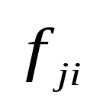

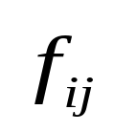
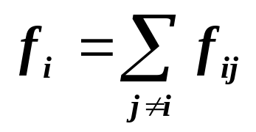
To ith particle（第i个粒子）, we introduce
j
Fi—the external force on the ith particle
fi —the internal force on the ith particle
i
Apply Newton’s second law to the ith particle :
法向：
切向:

Slide 26

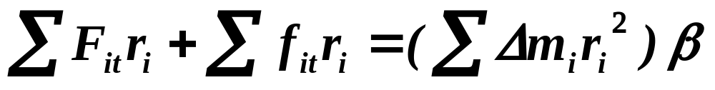
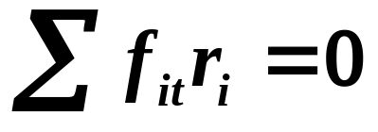
Multiplying（乘） both sides of second equation by , we have
Add all of equations for all particles
Considering
（内力成对出现）

Slide 27
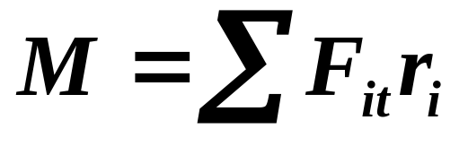
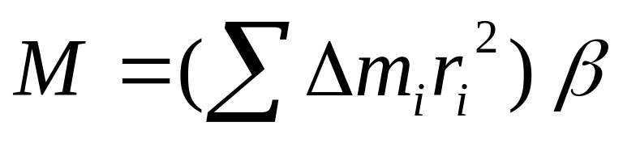
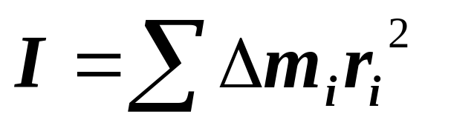
and the resultant torque of the external forces about the axis is
The sum（求和） on the right size is defined as the rotational inertia（转动惯量）of the body with respect to the axis and labeled as I (转动惯量定义)
(6-16)
（注意：有的书用J表示）

Slide 28
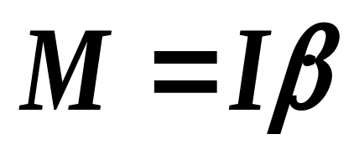
刚体定轴转动的转动定律
the law of rotation
(6-17)
Equation (6-17) is called as the law of rotation .转动定理表明角加速度与力矩成正比，与转动惯量成反比。
P
轴

Slide 29
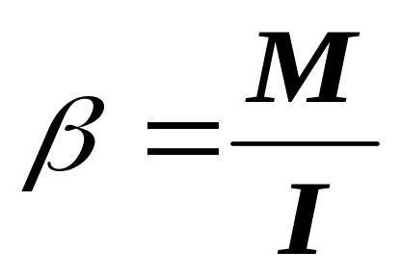
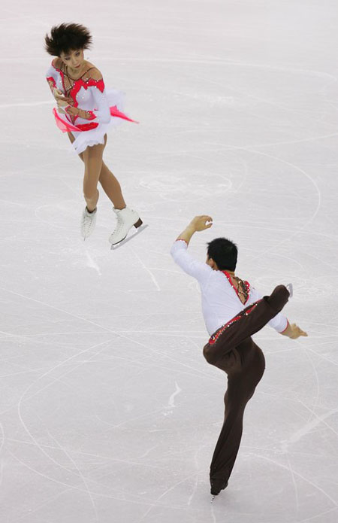
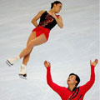
Eq.(3.2) has exactly the same form as that for acceleration of a particles, by which the rotation of a rigid body is governed(控制）. Therefore, it is often regarded as（称为） Newton’s second law for rotation.

Slide 30

3. Calculation of rotational inertia(转动惯量的计算):
The rotational inertial I is not a unique(唯一 ) property of the body but depends on the axis. Rotational inertial of a body is determined by:
(1) the total mass of the body(总质量）;
(2) the mass distribution of the body（质量的分布）;
(3) the position of the axis（转轴的位置）.

Slide 31
We can use the following example to show above con-clusion (结论）
axis
三个刚体，质量相等，因转轴位置或质量分布不同，转动惯量不相等；
axis
axis

Slide 32



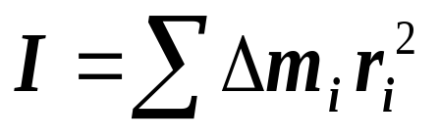



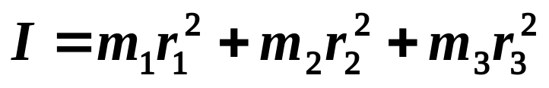
If the mass distribution of a body is known, its rotational inertial may be calculated as follows:
质量离散分布的物体:
（会计算简单分离物体的I）
axis
Example:

Slide 33
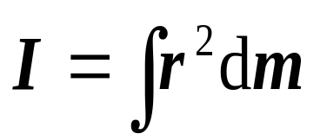
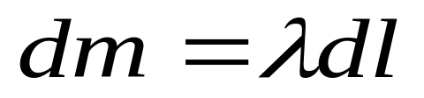
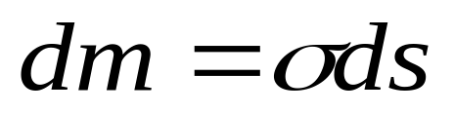
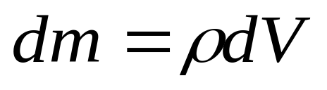
质量连续分布的物体:
（6-24）
质量为线分布
其中λ、σ、ρ分别为质量的线密度、面密度和体密度。
质量为面分布
质量为体分布
线分布
面分布
体分布

Slide 34
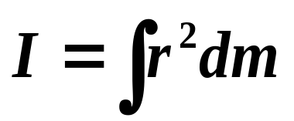
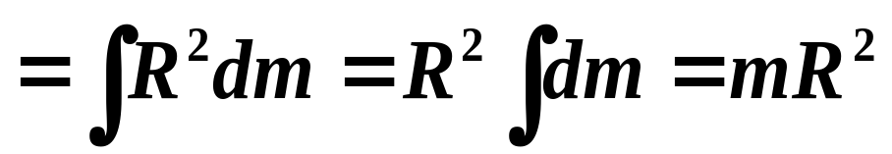
例1、求质量为m、半径为R的均匀圆环的转动惯量。轴与圆环平面垂直并通过圆心。
解:
O
R
dm
I是可加的，所以若为薄圆筒（不计厚度）结果相同。

Slide 35


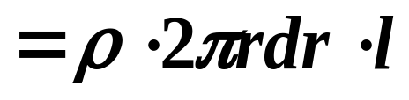
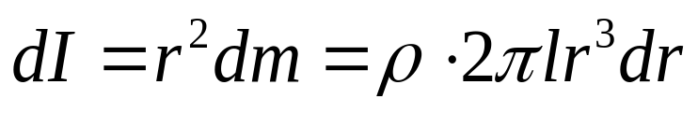


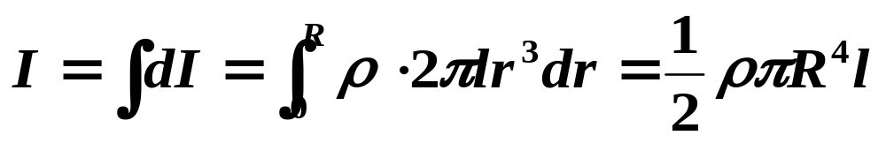
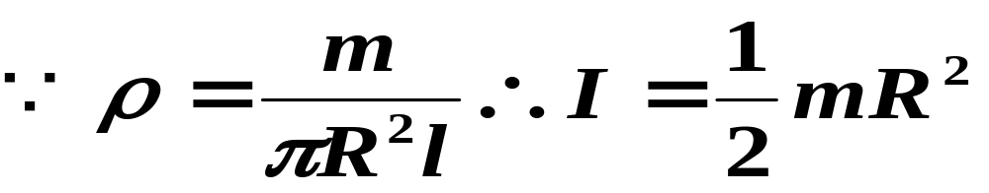
例2、求质量为m、半径为R、厚为l 的均匀圆盘的转动惯量。轴与盘平面垂直并通过盘心。
解：取半径为r宽为dr的薄圆环,
可见，转动惯量与l无关。所以，实心圆柱对其轴的转动惯量也是mR²/2。

Slide 36
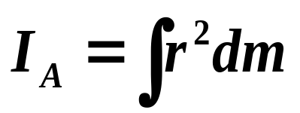



例3、求长为L、质量为m的均匀细棒对图中不同轴的转动惯量。
解：取如图坐标，dm=λdx
B
A
L
X
C
B
A
X
L/2
L/2

Slide 37
3. Applying the Law of rotation
转动定律的应用（important!!!!)
基本步骤
（1）隔离法选择研究对象；
（2）受力分析和运动情况分析；
（3）对质点用牛顿定理，对刚体用转动定理；
（4）建立角量与线量的关系，求解方程；
（5）结果分析及讨论。

Slide 38

Example 4: 一个质量为M，半径为R的定滑轮（当作均匀圆盘）上面绕有细绳。绳的一端固定在滑轮边上，另一端挂一质量为m的物体而下垂。忽略轴处摩擦，求物体m由静止下落h高度时的速度和此时滑轮的角速度(定滑轮的转动惯量 ）。
解：(1)研究对象：滑轮和物体m;
o
(2)受力分析如图：
滑轮：T、Mg、和轴的支持力，只有T产生力矩（why?)，顺 时针转动；
M
m
x
T
T
物体：mg和T，向下运动
mg

Slide 39






o
（3）对滑轮：
M
对物体m：
m
x
滑轮和物体的运动学关系为:
（4）以上三式联立，可得物体下落的加速度和速度：
这时滑轮转动的角速度为

Slide 40



Example 5:如图，长为L质量为m的匀质棒，可绕其通过端点的光滑轴在竖直平面内转动。求棒从水平位置转到图中位置的角加速度（ ）。
解：（1）研究对象：棒；
（2）受重力作用，可证明重力对转轴的力矩为：
θ
mg
（3）由转动定理，可得：

Slide 41


4. Kinetic energy and work in rotational motion
定轴转动中的动能和功
Kinetic Energy of Rotation
转动动能
A moving body has the kinetic energy. What is the kinetic energy of a rotating body?
Windmill（风车）
唐吉.可德（？）
风力发电，水轮机等

Slide 42







How can we get the expression（表达式） of kinetic energy of a rigid body in rotational motion ? — Treat the body as a collection of particles.
(1) Write the ith particle’s kinetic energy as
(2) Take the sum of kinetic energies over all the particles that make up the body:
axis

Slide 43




That is
axis
(转动动能)
(对比质点平动动能)

Slide 44

2. Work done by torque Kinetic theorem of rotation
力矩的功 刚体定轴转动的动能定理
(1) Work done by torque
When a torque acts on a rigid body, the rigid body starts to rotate with an angular acceleration so that it store the kinetic energy. This fact shows that the torque have done work on the rigid body.

Slide 45







In the following, for simplicity, we consider only a force applied at point P of a rigid body rotating about a fixed axis through o as shown in Figure.
axis
Fig. 3.17
Supposing that the rigid body rotates through a element angular displacement, the work done by the force is

Slide 46


The total work done during an angular displacement is then
(3.14)
In the special case of M is a constant
axis
Fig. 3.17

Slide 47





(2) Kinetic energy theorem of rotation 转动动能定理
Rewrite the element work
axis
Fig. 3.17

Slide 48




When the angular speed changes from to , the work done by the torque is
末动能
初动能
(3.17)
Equation (3.17) indicates that the work done by torque equals to the increment （增量）of kinetic energy of rotation. This is kinetic theorem of rotation.

Slide 49




Example 6. 质量为m、长为L的均质细杆可绕水平光滑轴O在竖直平面内转动。若使杆从水平位置开始由静止释放，试求杆转至铅垂位置时的角速度。
解：可利用动能定理来求解。
当杆的位置由θ 转到θ +dθ 时，重力矩所做元功为：
θ
mg
两边积分得：

Slide 50


由定轴转动动能定理有：
（事实上，这就是机械能守恒）

Slide 51


5 Angular Momentum（角动量）of a Rigid body Conservation of Angular momentum角动量守恒定律
1. Angular Momentum of a Rigid body
As shown in the figure, the angular momentum of the rigid body about the fixed axis with an angular speed ω is defined as
轴
ω
刚体对定轴的角动量

Slide 52





2. Conservation of Angular momentum
刚体组对轴的角动量守恒定律
外力矩对系统的角冲量（冲量矩）等于角动量的增量。
对轴的角动量守恒定律
外力对某轴的力矩之和为零，则该物体对同一轴的角动量守恒

Slide 53



角动量守恒定律的两种情况：
1、转动惯量保持不变的刚体
例：回转仪
2、转动惯量可变的物体
例：旋转的舞蹈演员

Slide 54


Slide 55



刚体转动定律的另一种形式
刚体所受的外力矩等于刚体角动量对时间的变化率。

Slide 56








例 讨论下列各过程中动量、角动量、机械能是否守恒？
（1）如图3.17a为一质量不计的细绳吊着一沙袋，子弹击入沙袋的过程. 以子弹和沙袋为系统.
（2）如图3.17b为一刚性杆可绕支点O自由转动，子弹击入杆的过程. 以子弹和杆为系统.
（3）如图3.17c为圆锥摆系统，圆锥摆摆动的过程. 以
圆锥摆为系统.
子弹击入杆
图3.18a
图3.18b
图3.18c

Slide 57
子弹击入杆
图3.18a
图3.18b
图3.18c
讨论 （1）如图3.18a以子弹和沙袋为系统. 由于子弹击入沙
袋的过程中，系统所受的合外力为零，合外力对O的力矩为
零，所以该过程，系统动量守恒，角动量守恒. 由于子弹击
入沙袋的过程中，子弹与沙袋间的摩擦阻力将作功，所以
系统机械能不守恒.

Slide 58
子弹击入杆
图3.18a
图3.18b
图3.18c
（2）如图3.18b以子弹和杆为系统. 子弹击入杆的过程，
由于o 轴对杆的作用力不能忽略，系统所受的合外力不
为零. 但由于o 轴对杆的作用力过o 轴，对o的力矩为零，
系统所受的合外力矩为零. 子弹击入杆的过程，子弹与
杆间的摩擦阻力将作功. 所以该过程，系统动量不守恒，
角动量守恒，机械能不守恒 .

Slide 59
子弹击入杆
图3.18a
图3.18b
图3.18c
（3）如图3.18c的圆锥摆系统. 圆锥摆摆动的过程，系统所受的合外力不为零； 但张力T的作用线通过oo‘轴，不产生力矩. 重力G与oo’轴平行，也不产生力矩；即合外力对o‘轴的力矩为零. 圆锥摆摆动的过程，没有任何力作功；所以该过程，系统动量不守恒，角动量守恒，系统机械能守恒.

